Slide 1
Happy Valley Kennel, Inc
Presented by:
Laine Perry, Keyur Shah, Gowtham Reddy Kota, Sruthi Kalidindi

Slide 2
Project Overview
01
04
Objectives and Description
Schedule
02
05
Project Environment
Budget
03
06
Preliminary Investigation
Documentation and Communication
Purpose
Project History
Scope
Timeline
Milestones
Participants
Problems and Opportunities
Constraints and Vision
Total Cost of Ownership
Estimated Costs
Findings and Analysis
Preliminary Solutions/Ideas
Feasibility
Procedures and Organization
LP

Slide 3
PROJECT DESCRIPTION

Slide 4





Project Objectives
Improve the current system and streamline day-to-day operations
Automate “Reservation and Care System”
Retain good customers through data visualization
Seek Operations Manager
LP

Slide 5
Project History
MANUALLY INTENSIVE
NO WEBSITE OR DATABASE
MANUAL TRACKING
LP

Slide 6
PROJECT HISTORY
Relies heavily on handwritten and verbal communication
Human error
Inconsistency
75% of appointments are made via telephone
Reservation Process
Customer arrives
Kennel Card updated/created
Contract is drawn manually using Kennel Card data
Pet is assigned to run
LP

Slide 7

SCOPE OF PROJECT
Main Process: Happy Valley Kennel
Reservations/Bookings
Run Placement
External
Customers
Suppliers
Veterinarians
LP

Slide 8
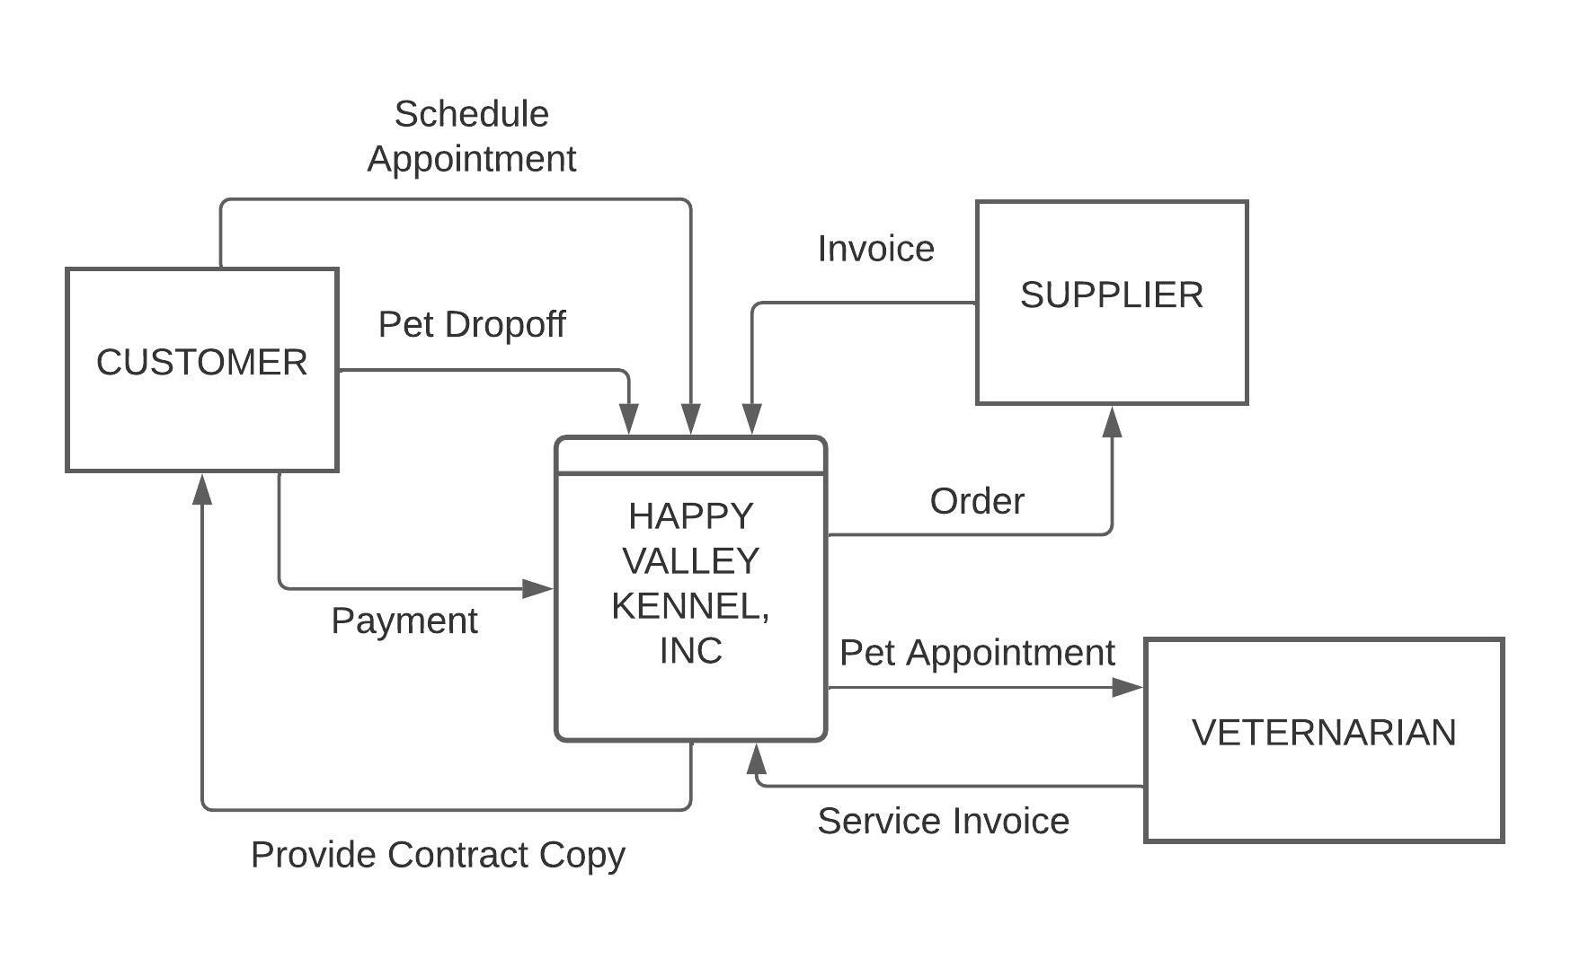
CURRENT SCOPE
LP

Slide 9
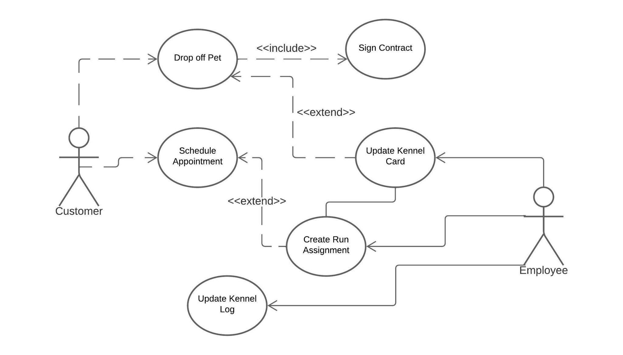
CURRENT SCOPE
LP

Slide 10
PROJECT ENVIRONMENT

Slide 11
PARTICIPANTS
Management – Direct Users, Sponsors or Managers of the System
Jim – Owner
Sally – Owner
Part-time Employees
Non-Management – Direct/End Users of the System
Customers
Example: Willis’s – Customer
Project Team Members
Laine Perry
Keyur shah
Gowtham reddy Kota
Sruthi kalidindi

Slide 12
PROBLEMS
Distinguishing good customers and less desirable customers
Example: Customers may not show up to their appointments
Example: Customer does not honour contract and leaves dog at kennel
Manually intensive processes
Leads to errors in data
Potential to misplace records of customers and pets
Time-intensive
No policy to prevent animals from getting sick
No vaccination records required
“Good” customers may not return if their pet gets sick after stay

Slide 13
OPPORTUNITIES
Development of website
Easy to manage booking system
Assists in reporting on bad customers and retaining good customers
Provides safe storage for customer records
Online connection with potential customers
Reduces manual work through automating booking process and tools such as the kennel card and kennel log
Hiring full-time Operations manager
Takes care of day-to-day operations
Updates website (i.e. updates basic information, posts photos, etc.)
Retaining “good” customers
Offering discounts to loyal customers
Developing a loyalty program
Potential to create policies to require certain vaccinations or health checks for pets. Owners will feel safe knowing their dog is surrounded by other healthy pets.

Slide 14

PROJECT CONSTRAINTS
Current employees may not have the skill/knowledge to operate a new system.
Limitation on budget may not be sufficient for all requests
Time will need to be spent to train new employees as well as existing employees on the new system.
Addition of new features or additional requests could impact the critical path for this project. Could risk a decrease in quality performance.
Failure to anticipate potential risks or problems may affect timeline.

Slide 15
Project Vision
The vision of the project is to create an information system for Happy Valley Kennels Inc. and help them to compete with their competitors by providing them with the best information system and benchmark their service offerings.

Slide 16
PRELIMINARY INVESTIGATION

Slide 17
FINDINGS AND ANALYSIS
Companies must not forget the feasibility through accurate research. One way to assess your ability to accept and work with your baby care unit is to perform a SWOT analysis to look at its strengths, weaknesses, opportunities, and threats.
STRENGTHS: less competition, experience, lower cost
WEAKNESSES: lack of technology knowledge,lack of marketing
OPPORTUNITIES: Once your organisation will become worthwhile there are numerous opportunities ahead for expanding business
THREATS: Competition is certainly considered one of the largest threats to any new Pet care center

Slide 18
PRELIMINARY SOLUTIONS AND IDEAS
DEVELOP WEBSITE
Using the phone as the primary tool to schedule a visit is time-consuming for employees and can take away from the provided care of pets. Phone calls also limit the number of customers who can schedule appointments.
Since the internet is widely available, using an online form through a website saves time for both the customer and employees. Phone calls and walk-ins will still be available but less common.
Additionally, a website provides numerous opportunities to keep customers up to date on promotions, events, hours, or provide images of the facility.

Slide 19
PRELIMINARY SOLUTIONS AND IDEAS (cont.)
A website can replace your current Kennel Card filing system. A website will provide storage to record details about individual pets and customers.
A database can hold information about individual pets and customers.
Example: A single pet ID can identify information such as food preferences, vaccinations, allergies, owner’s address, emergency number, special request , type of breed, and also details of run time; all data is retrieved from online form to this system
A database provides a source to use when creating visual representations of data for good and less desirable customers

Slide 20
PRELIMINARY SOLUTIONS AND IDEAS (cont.)
Hiring manager
If you presently manage all of the control responsibilities yourself, hiring a manager can lose up a while to awareness at the maximum crucial obligations you experience doing and assist you develop your commercial enterprise.
Many commercial enterprise proprietors lease managers because the corporation grows or once they experience they`re unfold too thin. Consider whether or not it`s time to feature every other stage of control to assist your commercial enterprise run greater efficiently.

Slide 21
PROJECT FEASIBILITY STUDY
Operational Feasibility
Website reduces handwritten work of kennel card and phone call booking. It can also assist in reaching potential clients
Manual work and phone call booking are time-consuming. A website reduces time by providing automation and less human intervention
A website can lead to business growth and reaches to people outside a business’s regular foot traffic

Slide 22
PROJECT FEASIBILITY STUDIES (cont.)
Economic Feasibility
Selections collectively primarily based totally at the effects
Development Costs
One-time prices for the project
Estimates enhance as greater element is given
Personnel Costs

Slide 23
PROJECT FEASIBILITY STUDIES (cont.)
Economic Feasibility
Salaries of all individuals that broaden the device
Additionally consists of benefits
User Time
Training Costs
Equipment Costs

Slide 24
PROJECT FEASIBILITY STUDIES (cont.)
Technical Feasibility
First website for small business required web form, data of customer, need technical person to handle website.
Business has a lot of potential to grow and expand in the near future.
Website contain is nearly 10 - 15 pages

Slide 25
PROJECT FEASIBILITY STUDIES (cont.)
Schedule Feasibility
Website can be created in around 60 - 65 day during that time. First we give you some template where you select anyone you like.
In the second phase we give you a BETA website for testing.
If you feel it is difficult to use you can let us know and we will fix it.
In the third phase a third party will implement the whole website.

Slide 26
PROJECT PLAN SCHEDULE

Slide 27
PROJECT PLAN SCHEDULE
Start and End Date of the Project Design would be February 1st to April 27th.
Project Implementation would start at May 1st and End at June 31st.
The Manager would work on the Project Evaluation and Review Technique (PERT) / Critical Path Method (CPM) in order to break large activities into different Sub Activities.

Slide 28
PROJECT PLAN SCHEDULE
Different Activities that include in the Project are:
Planning
Hiring Manager
Training Manager
Record Customer Data
Website Template
Approved Website Design
Complete Website Design
Implement
Follow up

Slide 29
PERT CHART
Hire Manager
Training Manager
Record Customer Data
Planning
Implement Website
Follow up
Website Template
Approved Website Design
Complete Website Design

Slide 30
CALCULATING THE CRITICAL PATH
Activity | Earliest Start | Earliest Finish
Activity Time | Latest Start | Latest Finish
In order to calculate the Critical Path we would need different Time Estimates.
Earliest Finish = Earliest Start + Activity Time
Latest Start = Latest Finish - Activity Time
Slack = Earliest Start - Latest Start
Or
Slack = Earliest Finish - Latest Finish

Slide 31
CALCULATING THE CRITICAL PATH
Actual Activity | Planning | Hire Manager | Website Template | Train Manager | Record Customer Data | Approved Website Design | Complete Website Design | Implement Website | Follow up
Activity | A | B | C | D | E | F | G | H | I
Immediate Predecessors | - | A | A | B | D | C | F | E,G | H
Expected Time (Weeks) | 2 | 1 | 3 | 2 | 2 | 3 | 2 | 4 | 1

Slide 32
Calculating the Critical Path
SLACK = 3
SLACK = 3
SLACK = 3
SLACK = 0
B | 2 | 2
1 | 5 | 6
D | 3 | 5
2 | 6 | 8
E | 5 | 7
2 | 8 | 10
SLACK = 0
SLACK = 0
A | 0 | 2
2 | 0 | 2
H | 10 | 14
4 | 10 | 14
I | 14 | 15
1 | 14 | 15
C | 2 | 5
3 | 2 | 5
F | 5 | 8
3 | 5 | 8
G | 8 | 10
2 | 8 | 10
SLACK = 0
SLACK = 0
SLACK = 0

Slide 33
CRITICAL PATH
The Critical Path of the Project would be
Planning - Website Template - Approved Design - Complete Website Design - Implementation - Follow up
Hiring Manager - Train Manager - Record Customer
This path might be delayed for 3 weeks which will not affect any of the Project plan and schedule.

Slide 34
PROJECT BUDGET

Slide 35
PROJECT BUDGET
Planned initial budget of the project would be $120,000 - $150,000. It might increase based on the ongoing costs and Proposed Systems.
Website building cost and maintenance cost depending on stakeholder’s selection of domain and design.
Reference: https://www.websitebuilderexpert.com/building-websites/how-much-should-a-website-cost/

Slide 36
PROJECT BUDGET
Website Domain | $12 - $60 P/Y
Website Hosting | $35 - $600 P/m
SSL Certificate | $0 - $200 P/m
Website Template or Theme | $0 - $200
Ecommerce Functionality | $20 - $24,000
Website content | $0 - $5,000
Apps and Integrations | $0 - $100
SEO and Marketing | $0 - $90

Slide 37
PROJECT BUDGET
Maintenance of Website: First 2 years we gives you free service and then we charge around $2000 per year.
Cost of training is around $1000 our team person comes to your facility and trains you about how to use and what things you have to take care of.
Cost of web server: one time cost $2539.
Reference: https://www.dell.com/en-us/work/shop/servers-storage-and-networking/poweredge-t440-tower-server/spd/poweredge-t440/pe_t440_tm_vi_vpq3?gacd=9650523-1034-5761040-266691960-0&dgc=st&gclid=CjwKCAiAx8KQBhAGEiwAD3EiP9hdu5tRbyI6nepQ_m61AFv89SK7cWo7CU-OB3h2s3i7xy-Wg9ay-hoCTAYQAvD_BwE&gclsrc=aw.ds&nclid=_ArbLeHEBZdnC--MFAFghRxP5dCoSN6wSYHD0C6URWI1Ipa7DfAcEg2iW7JJsIkM

Slide 38
PROJECT BUDGET
Cost of development : Websites with custom design and features need a $5,000 – $10,000 investment.
Total Cost of Ownership basic for year
1st year =$17739 plus taxes.
2nd year = $11739 plus taxes.
3rd year $13739 plus taxes
4th year $13739 plus taxes
5th year $13739 plus taxes

Slide 39
PROJECT DOCUMENTATION AND COMMUNICATION

Slide 40
PROJECT DOCUMENTATION AND COMMUNICATION
Presentations and Project deliverables which are created to submit to stakeholder.
Project Documentation Starts from Fact Finding phase and continues during the Implementation Phase
Operational Documentation includes the input files, Output files and their destinations.
Errors or issues we face during the implementation of the Project.
Changes made when we work on implementing the Design.
Financial reports and Documents of the Employees.

Slide 41
PROJECT DOCUMENTATION AND COMMUNICATION
Stakeholder Interviews and Communication through Reggienet.
Project Meetings which are held on Zoom and In-person.
Conversation through Outlook if there is anything to update something among the team members or to the Stakeholder

Slide 42
FINAL THOUGHTS
Automate “Reservation and Care System”
Website - powerful tool to automate bookings, collect data, reach new customers
Retain good customers and report on less desirable customers
Provide discounts and loyalty program through website
Understand customer trends through visualization of data
Seek Operations Manager to handle daily operations

Slide 43
QUESTIONS?

